Slide 1
Long Short Term Memory
Long short term memory is variant of Recurrent Neural Network.
Basically the job of LSTM is to hold long term dependencies which is necessary for longer sequences to train.
LSTM consist of forget gate which is useful in memorizing useful content and forget which is not useful.
LSTM also solves the vanishing gradient and exploding gradient problem of RNN.
LSTM has forget gate which activation is always close to 1. The effective weight of the recurrence is equal to the forget gate activation. This gives advantage to LSTM to solve that problem of both vanishing and exploding gradient.

Slide 2
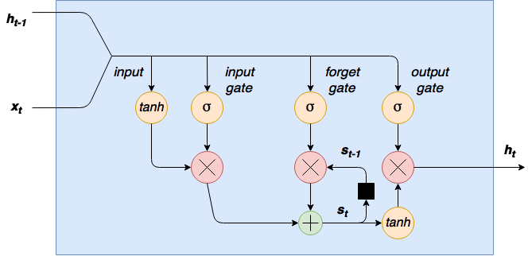
Architecture of LSTM

